Slide 1
Machine learning clustering algorithms-I

Slide 2
Supervised learning vs. unsupervised learning
Supervised learning: discover patterns in the data that relate data attributes with a target (class) attribute.
These patterns are then utilized to predict the values of the target attribute in future data instances.
Unsupervised learning: The data have no target attribute.
We want to explore the data to find some intrinsic structures in them.

Slide 3
What is Unsupervised Learning?
Unsupervised learning is a machine learning paradigm where the algorithm learns patterns and structures from input data without explicit supervision.
Unlike supervised learning, there are no labeled target variables. The algorithm must find inherent patterns on its own.
The primary goal is to explore and uncover underlying relationships and groupings in the data.

Slide 4
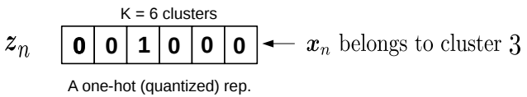
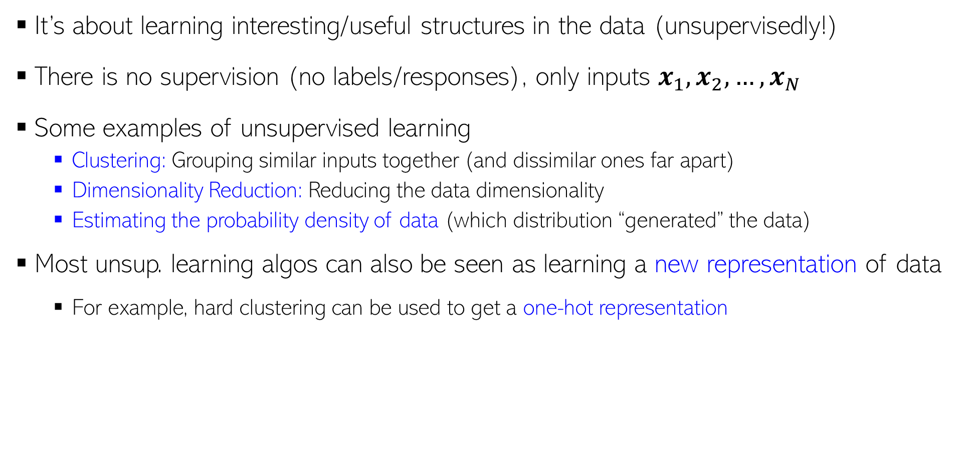
Cont.
It’s about learning interesting/useful structures in the data (unsupervisedly!)
There is no supervision (no labels/responses), only inputs $x_{1},x_{2},…, x_{N}$
Some examples of unsupervised learning
Clustering: Grouping similar inputs together (and dissimilar ones far apart)
Dimensionality Reduction: Reducing the data dimensionality
Estimating the probability density of data (which distribution “generated” the data)
Most unsup. learning algos can also be seen as learning a new representation of data
For example, hard clustering can be used to get a one-hot representation
Each point belongs deterministically to a single cluster

Slide 5
Clustering
Clustering is a technique for finding similarity groups in data, called clusters. I.e.,
it groups data instances that are similar to (near) each other in one cluster and data instances that are very different (far away) from each other into different clusters.
Clustering is often called an unsupervised learning task as no class values denoting an a priori grouping of the data instances are given, which is the case in supervised learning.
Due to historical reasons, clustering is often considered synonymous with unsupervised learning.
In fact, association rule mining is also unsupervised

Slide 6
Clustering techniques
Clustering has been studied extensively for more than 40 years and across many disciplines due to its broad applications.
k-Means algorithm [1957, 1967]
k-Medoids algorithm
k-Modes [1998]
Fuzzy c-means algorithm [1999]
Partitioning methods
Divisive
Hierarchical methods
Agglomerative methods
Clustering Techniques
Density-based methods
STING [1997]
DBSCAN [1996]
CLIQUE [1998]

Slide 7
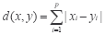
Common Distance measures:
Distance measure will determine how the similarity of two elements is calculated and it will influence the shape of the clusters.
They include:
1. The Euclidean distance (also called L2-norm distance) is given by:
2. The Manhattan distance (also called taxicab norm or L1-norm) is given by:

Slide 8
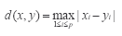
3. The maximum norm is given by:
The Mahalanobis distance corrects data for different scales and correlations in the variables.
Inner product space: The angle between two vectors can be used as a distance measure when clustering high dimensional data.
6. Hamming distance (sometimes edit distance) measures the minimum number of substitutions required to change one member into another.

Slide 9
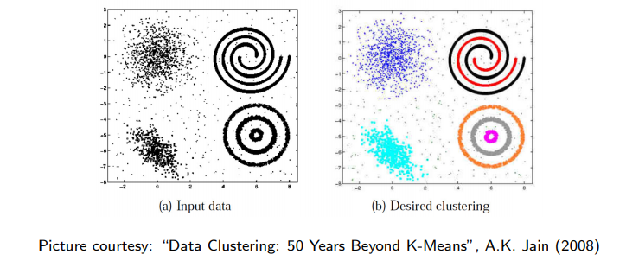
Let’s dive in…
In some cases, we may not know the right number of clusters in the data and may want to learn that (technique exists for doing this but beyond the scope)
Given: $N$ unlabeled examples $x_{1},x_{2},…, x_{N}$; desired no. of partitions $K$
Goal: Group the examples into $K$ “homogeneous” partitions
Loosely speaking, it is classification without ground truth labels
A good clustering is one that achieves
High within-cluster similarity
Low inter-cluster similarity

Slide 10
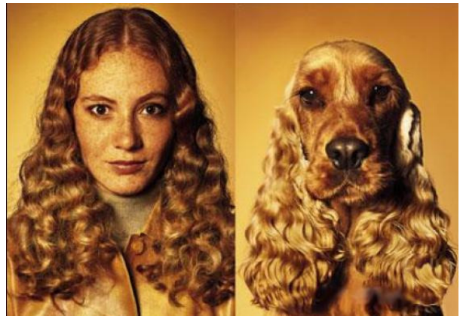
Similarity can be Subjective
Clustering only looks at similarities b/w inputs, since no labels are given
Without labels, similarity can be hard to define
Thus using the right distance/similarity is very important in clustering
In some sense, related to asking: “Clustering based on what”?
Picture courtesy: http://www.guy-sports.com/humor/videos/powerpoint presentation dogs.htm

Slide 11
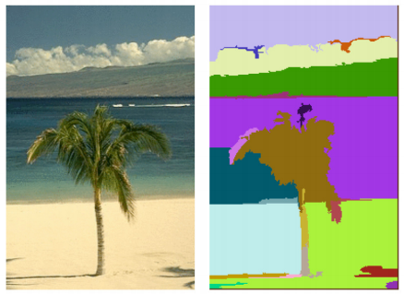
Clustering: Some Examples
Document/Image/Webpage Clustering
Image Segmentation (clustering pixels)
Clustering web-search results
Clustering (people) nodes in (social) networks/graphs
.. and many more..
Picture courtesy: http://people.cs.uchicago.edu/∼pff/segment/

Slide 12
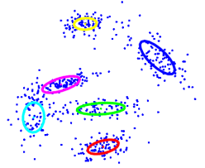
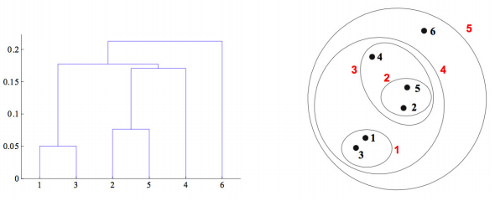
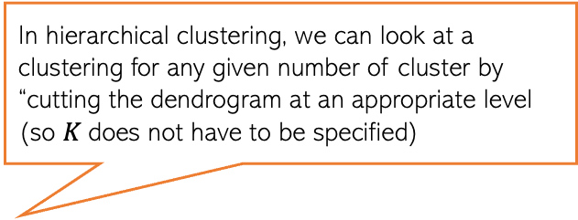
Types of Clustering
Flat or Partitional clustering
Partitions are independent of each other
Hierarchical clustering
Partitions can be visualized using a tree structure (a dendrogram)
In hierarchical clustering, we can look at a clustering for any given number of cluster by “cutting the dendrogram at an appropriate level (so $K$does not have to be specified)
Hierarchical clustering gives us a clustering at multiple levels of granularity

Slide 13
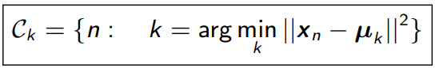
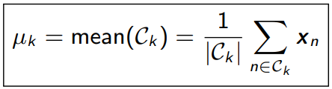

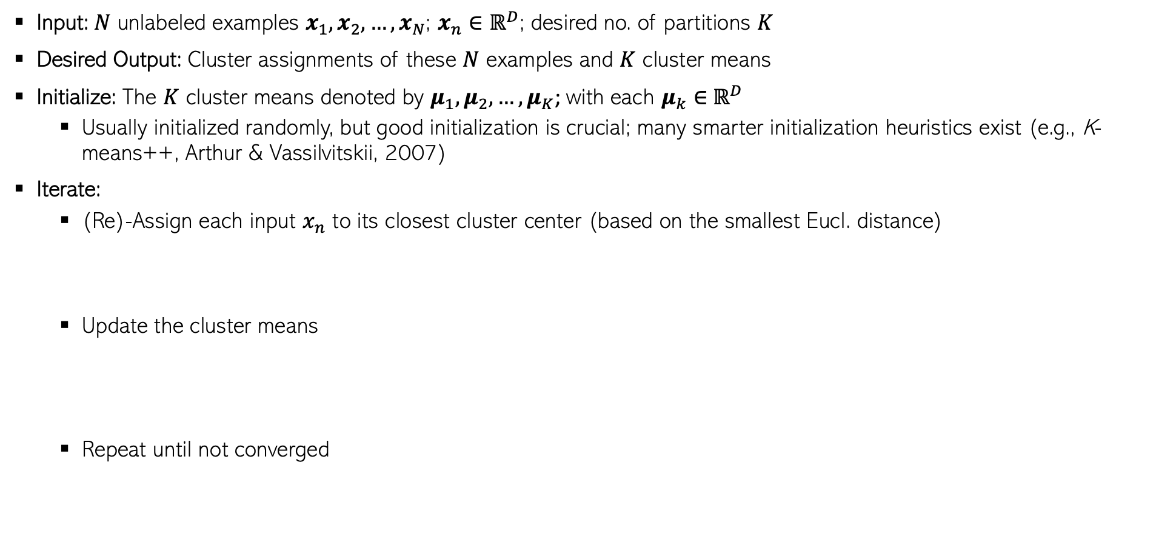
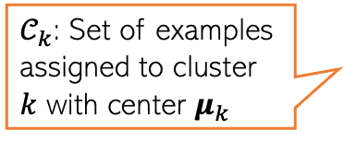
Flat Clustering: K-means algorithm (Lloyd, 1957)
Input: $N$ unlabeled examples $x_{1},x_{2},…, x_{N}$; $x_{n}∈ℝ^{D}$; desired no. of partitions $K$
Desired Output: Cluster assignments of these $N$ examples and $K$ cluster means
Initialize: The $K$ cluster means denoted by $μ_{1},μ_{2},…, μ_{K}$; with each $μ_{k}∈$ $ℝ^{D}$
Usually initialized randomly, but good initialization is crucial; many smarter initialization heuristics exist (e.g., K-means++, Arthur & Vassilvitskii, 2007)
Iterate:
(Re)-Assign each input $x_{n}$ to its closest cluster center (based on the smallest Eucl. distance)
Update the cluster means
Repeat until not converged
$𝒞_{k}$: Set of examples assigned to cluster $k$ with center $μ_{k}$
Some ways to declare convergence if between two successive iterations:
Cluster means don’t change
Cluster assignments don’t change
Clustering “loss” doesn’t change by much

Slide 14
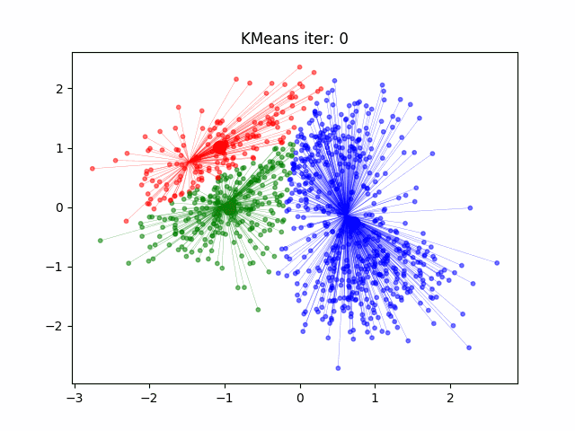
K-means: An Illustration

Slide 15
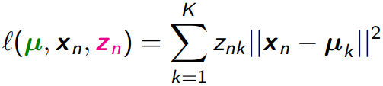
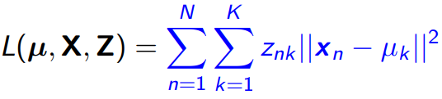
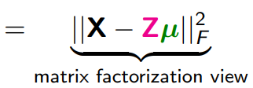
What Loss Function is K-means Optimizing?
$z_{n} =$[$z_{n1}$, $z_{n2}, …, z_{nK}$] denotes a length $K$ one-hot encoding of $x_{n}$
Let $μ_{1},μ_{2},…, μ_{K}$ be the K cluster centroids/means
Let $z_{nk}$ ∈ {0, 1} be s.t. $z_{nk}$ = 1 if $x_{n}$ belongs to cluster $k$, and 0 otherwise
Define the distortion or “loss” for the cluster assignment of $x_{n}$
Total distortion over all points defines the $K$-means “loss function”
The $K$-means problem is to minimize this objective w.r.t. $µ$ and $Z$
Alternating optimization on this loss would give the K-means (Lloyd’s) algorithm we saw earlier!

Slide 16
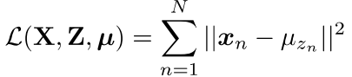
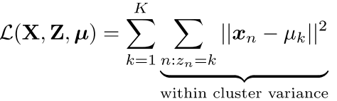
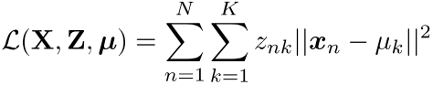
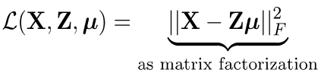
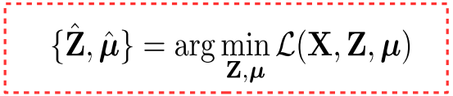
K-means Loss: Several Forms, Same Meaning!
Replacing the $ℓ_{2}$ (Euclidean) squared by $ℓ_{1}$ distances givesn the K-medoids algorithm (more robust to outliers)
Notation: $X$ is $N× D$
$Z$ is $N×K$(each row is a one-hot $z_{n}$ or equivalently $z_{n}$ $∈ \{1,2,…,K\}$)
$μ$ is K × D (each row is a $μ_{k}$)
Note: Most unsup. learning algos try to minimize a distortion or recon error
Distortion on assigning $x_{n}$ to cluster $z_{n}$
Total “distortion” or reconstruction error

Slide 17
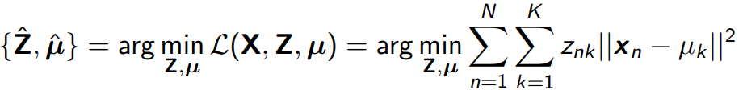
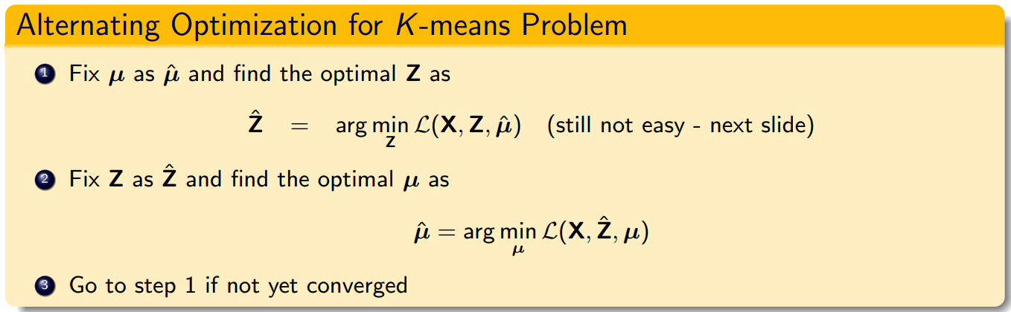
Optimizing the K-means Loss Function
So the $K$-means problem is
Can’t optimize it jointly for $Z$ and $μ$. Let’s try alternating optimization for $Z$ and $μ$

Slide 18
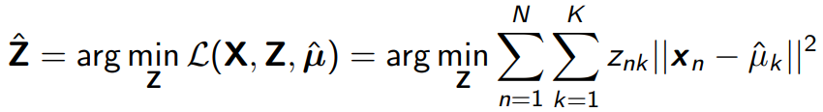
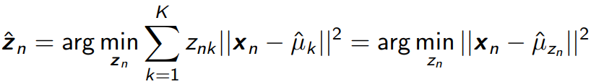
Solving for Z
Solving for $Z$ with $μ$fixed at $\hat{μ}$
Still not easy. $Z$ is discrete and above is an NP-hard problem
Combinatorial optimization: $K^{N}$ possibilities for $Z$ ($N × K$matrix with one-hot rows)
Greedy approach: Optimize $Z$ one row ($z_{n}$) at a time keeping all others $z_{n}$’s (and the cluster means $μ_{1},μ_{2},…, μ_{K})$ fixed
Easy to see that this is minimized by assigning $x_{n}$ to the closest mean
This is exactly what the $K$-means (Lloyd’s) algo does!

Slide 19
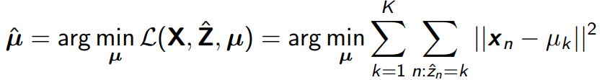
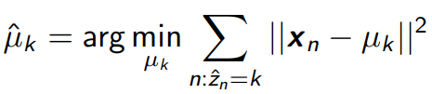
Solving for $μ$
Solving for 𝝁 with $Z$ fixed at $\hat{Z}$
Not difficult to solve (each $μ_{k}$ is a real-valued vector, can optimize easily)
Note that each $μ_{k}$ can be optimized for independently
(Verify) This is minimized by setting $\hat{μ_{k}}$ to be mean of points currently in cluster $k$
This is exactly what the $K$-means (Lloyd’s) algo does!

Slide 20
Initializing K-means.
Initializing K-means is the initial step of the K-means clustering algorithm, which is an unsupervised machine learning technique used for partitioning data points into K clusters.
The goal of K-means is to minimize the sum of squared distances between data points and their corresponding cluster centers, often referred to as centroids.

Slide 21
General process for initializing K-means
Choose the number of clusters (K): Decide the number of clusters you want to partition your data into. This is a user-specified parameter and requires domain knowledge or experimentation to determine the optimal value.
Select initial centroids: Randomly select K data points from your dataset as the initial centroids. These data points will serve as the starting positions for the cluster centers.
Assign data points to clusters: Calculate the distance between each data point and all the centroids. Assign each data point to the cluster with the nearest centroid. This step forms the initial clustering.

Slide 22
Cont.
4. Update centroids: Calculate the mean (center) of the data points within each cluster and move the centroids to these new positions.
5. Repeat steps 3 and 4: Continue steps 3 and 4 iteratively until convergence or until a specified number of iterations is reached. Convergence happens when the cluster assignments stop changing significantly or when the centroids stop moving substantially.
6. Final clustering: Once convergence is reached, the algorithm stops, and you have your final clustering result.

Slide 23
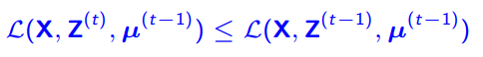
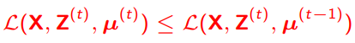
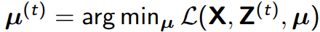
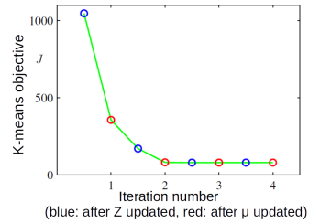
Convergence of K-means algorithm
Each step (updating $Z$ or $μ$) can never increase the $K$-means loss
When we update $Z$ from $Z^{(t−1)}$ to $Z^{(t)}$
When we update $μ$ from $μ^{(t−1)}$ to $μ^{(t)}$
Thus the $K$-means algorithm monotonically decreases the objective
because
because

Slide 24
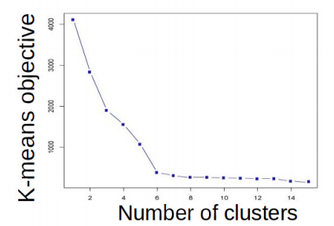
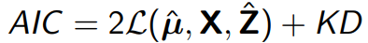
K-means: Choosing K
One way to select $K$ for the $K$-means algorithm is to try different values of $K$, plot the $K$-means objective versus $K$, and look at the “elbow-point”
Can also information criterion such as AIC (Akaike Information Criterion)
and choose K which gives the smallest AIC (small loss + large K values penalized)
More advanced approaches, such as nonparametric Bayesian methods (Dirichlet Process mixture models also used, not within K-means but with other clustering algos)
$K$=6 is the elbow point

Slide 25
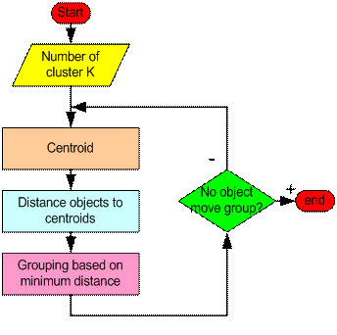
What have we learned so far…

Slide 26
Step 1: Begin with a decision on the value of k = number of clusters .
Step 2: Put any initial partition that classifies the data into k clusters. You may assign the training samples randomly, or systematically as the following:
Take the first k training sample as single-element clusters
Assign each of the remaining (N-k) training sample to the cluster with the nearest centroid. After each assignment, recompute the centroid of the gaining cluster.

Slide 27
Step 3: Take each sample in sequence and compute its distance from the centroid of each of the clusters. If a sample is not currently in the cluster with the closest centroid, switch this sample to that cluster and update the centroid of the cluster gaining the new sample and the cluster losing the sample.
Step 4: Repeat step 3 until convergence is achieved, that is until a pass through the training sample causes no new assignments.

Slide 28
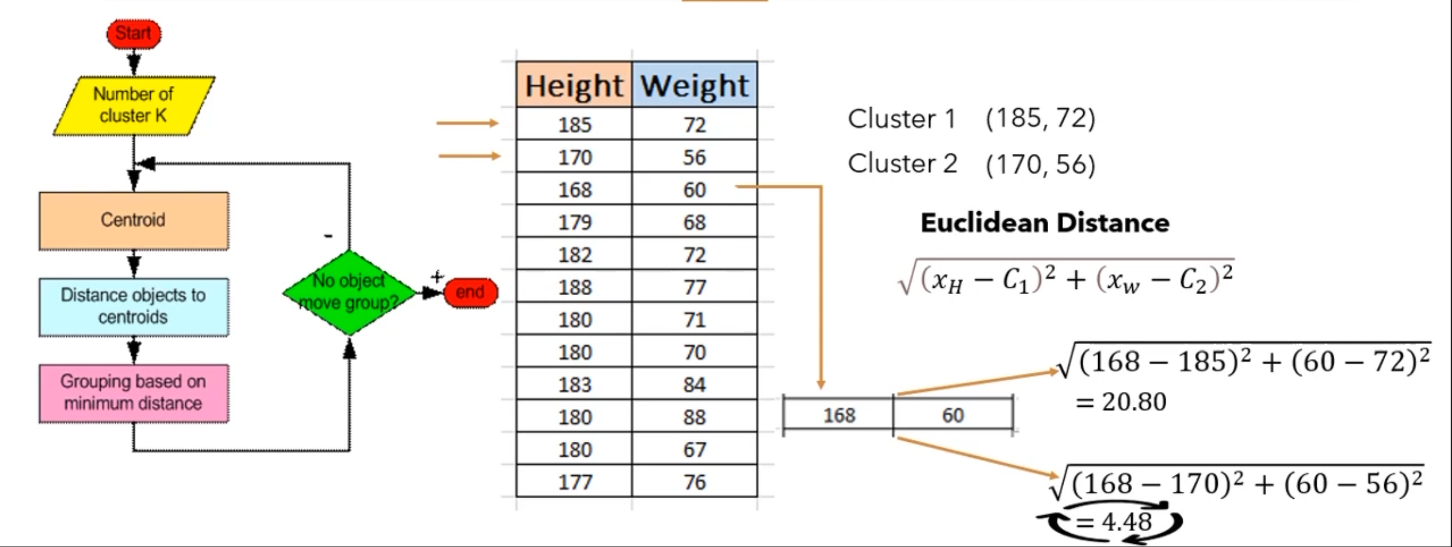

Slide 29
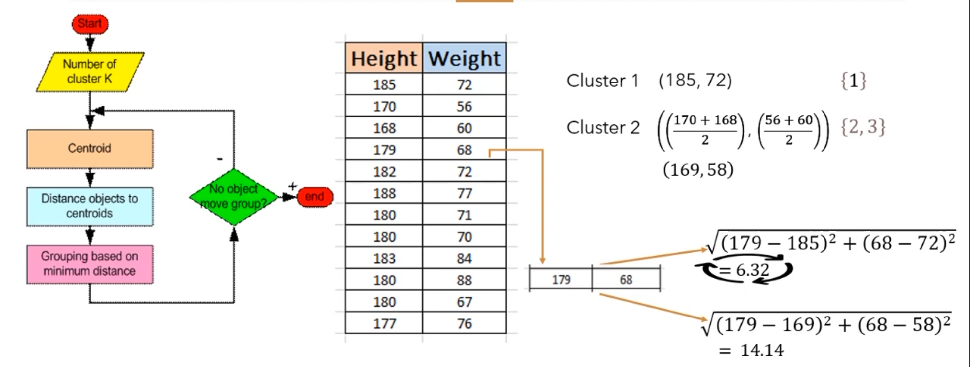

Slide 30
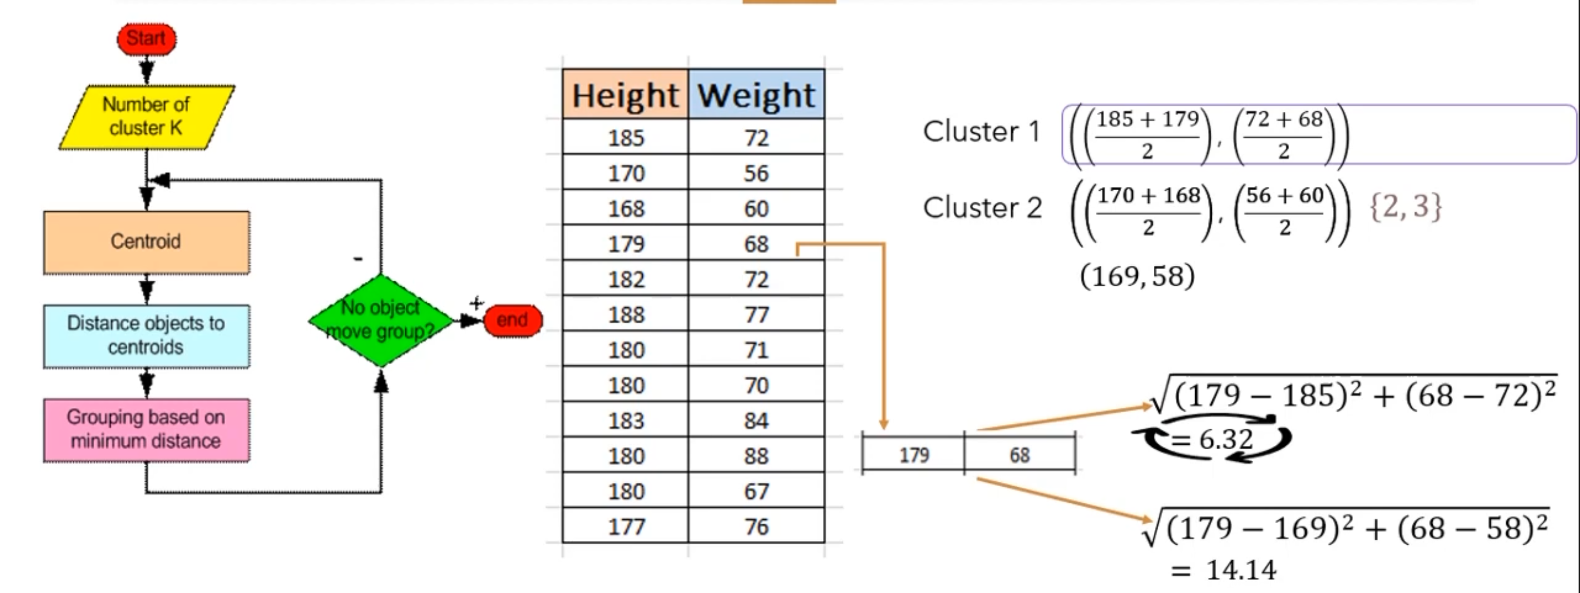

Slide 31
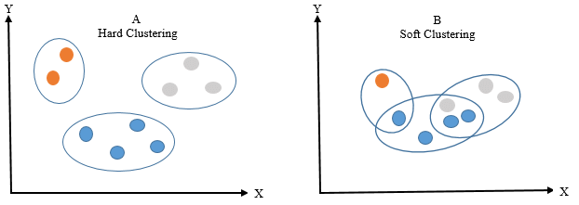
Hard vs Soft Clustering

Slide 32
Hard Clustering
Also known as Exclusive Clustering or Crisp Clustering.
Each data point is assigned to exactly one cluster.
Results in non-overlapping clusters with clear boundaries.
E.g., K-means

Slide 33
Advantages
Simplicity and Ease of Implementation: Hard clustering algorithms are straightforward to understand and implement.
Computational Efficiency: Ideal for handling large datasets efficiently.
Clear Cluster Membership: Each data point unambiguously belongs to a single cluster.
Disadvantages
Sensitive to Initial Placement: Results can vary depending on the initial cluster centroids.
Limited Handling of Overlapping Data: May struggle with complex data structures that have overlapping clusters.
Impact of Outliers: Outliers can significantly affect cluster assignments.

Slide 34
Soft Clustering
Also known as Fuzzy Clustering.
Allows data points to belong to multiple clusters with varying membership degrees.
Provides more flexibility and captures uncertainty in cluster assignments.
E.g., Fuzzy C-means (FCM)

Slide 35
Advantages
Nuanced Cluster Assignments: Data points can have partial membership in multiple clusters, providing a more nuanced representation.
Handling Overlapping Data: Well-suited for datasets with complex or overlapping structures.
Robustness to outliers: The ability of a clustering algorithm to minimize the influence of outliers on the assignment of data points to clusters. (probability distribution over clusters instead of a hard assignment to a single cluster)
Disadvantages
Computational Complexity: Soft clustering methods can be more computationally expensive than their hard clustering counterparts.
Determining the Number of Clusters: Requires the pre-specification of the number of clusters or fuzziness coefficient.
Interpretability Challenges: Fuzzy memberships might be more challenging to interpret.

Slide 36
How to Find the Optimal Number of Clusters
The elbow method is a popular technique used to determine the optimal number of clusters (k) in a clustering algorithm, such as K-means.
It involves plotting the cost (inertia) of clustering as a function of the number of clusters and looking for the "elbow point" in the plot.
The elbow point is the value of k at which the inertia starts to level off or decrease at a slower rate.
This point indicates that adding more clusters does not significantly improve the clustering quality and suggests the appropriate number of clusters for the data.

Slide 37
Cont.
The elbow method helps us find the optimal number of clusters for our data.
It involves analyzing the inertia (within-cluster sum of squares) as a function of the number of clusters.

Slide 38
Elbow Method: Step by Step
Choose a range of k values to consider (e.g., 1 to 10).
For each k value, run the K-means algorithm with k clusters on the data.
Calculate the inertia (sum of squared distances within clusters) for each k.
Plot the inertia values against the corresponding k values.

Slide 39
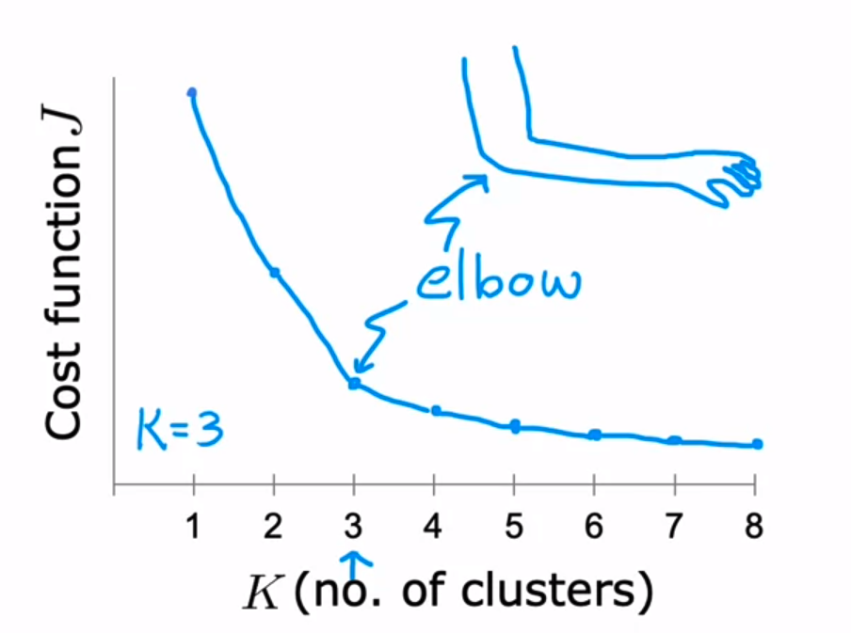
Cont.

Slide 40
Identifying the Elbow Point
The elbow point is the optimal k value.
It is the point where inertia starts to level off or decreases at a slower rate.
Adding more clusters beyond this point may not significantly improve clustering quality.

Slide 41
Limitations of the Elbow Method
The elbow method may not always yield a clear-cut elbow point, especially for complex datasets.
It is subjective, and the optimal k value may vary based on interpretation.

Slide 42
Weaknesses of K-Mean Clustering
When the numbers of data are not so many, initial grouping will determine the cluster significantly.
The number of cluster, K, must be determined before hand. Its disadvantage is that it does not yield the same result with each run, since the resulting clusters depend on the initial random assignments.
We never know the real cluster, using the same data, because if it is inputted in a different order it may produce different cluster if the number of data is few.
It is sensitive to initial condition. Different initial condition may produce different result of cluster. The algorithm may be trapped in the local optimum.

Slide 43
Applications of K-Mean Clustering
It is relatively efficient and fast. It computes result at O(tkn), where n is number of objects or points, k is number of clusters and t is number of iterations.
k-means clustering can be applied to machine learning or data mining
Used on acoustic data in speech understanding to convert waveforms into one of k categories (known as Vector Quantization or Image Segmentation).
Also used for choosing color palettes on old fashioned graphical display devices and Image Quantization.

Slide 44
CONCLUSION
K-means algorithm is useful for undirected knowledge discovery and is relatively simple.
K-means has found wide spread usage in lot of fields, ranging from unsupervised learning of neural network, Pattern recognitions, Classification analysis, Artificial intelligence, image processing, machine vision, and many others.

Slide 45
Kmeans++
KMeans++ is an improved initialization technique for the KMeans clustering algorithm.
The primary goal of KMeans++ is to provide a better initial set of cluster centroids, which in turn leads to faster convergence and higher-quality clustering results compared to the standard random initialization used in traditional KMeans.
(Problem with kmeans)
Different initialization will result in different clusters.

Slide 46
Kmeans++ Algorithm
Select the First Centroid:
Choose one data point randomly from the dataset as the first centroid.
Calculate Distances:
For each data point that has not been selected as a centroid, calculate the distance (usually using Euclidean distance) from that point to the nearest centroid that has already been chosen.
Select Subsequent Centroids:
The next centroid is chosen from the remaining data points with a probability proportional to the square of the distance from the nearest existing centroid. This ensures that points that are far from existing centroids are more likely to be selected as new centroids.
Repeat Step 2 and 3:
Repeat the distance calculation and centroid selection process until the desired number of centroids is reached.

Slide 47
Kmeans++ Numerical
Let's say we have a small dataset of two-dimensional points:
Data Points:
(2, 3), (3, 2), (8, 8), (10, 9), (11, 10)
We want to perform KMeans clustering with K=2 clusters.

Slide 48
Step 1
Select First Centroid:
Choose a random data point as the first centroid. Let's say we choose (2, 3).

Slide 49
Step 2
Calculate Distances:
Calculate the squared distances from each data point to the chosen centroid (2, 3):
Distance from (3, 2) = (3 - 2)^2 + (2 - 3)^2 = 2
Distance from (8, 8) = (8 - 2)^2 + (8 - 3)^2 = 61
Distance from (10, 9) = (10 - 2)^2 + (9 - 3)^2 = 100
Distance from (11, 10) = (11 - 2)^2 + (10 - 3)^2 = 130

Slide 50
Step 3
Select Subsequent Centroid:
The next centroid is selected based on the calculated squared distances. The probability of selecting a point as the next centroid is proportional to its squared distance from the nearest existing centroid.
Calculate the probabilities for each point:
Probability for (3, 2) = 2 / (2 + 61 + 100 + 130) ≈ 0.0068
Probability for (8, 8) = 61 / (2 + 61 + 100 + 130) ≈ 0.2081
Probability for (10, 9) = 100 / (2 + 61 + 100 + 130) ≈ 0.3412
Probability for (11, 10) = 130 / (2 + 61 + 100 + 130) ≈ 0.4436
Choose the next centroid based on these probabilities. (11, 10) is selected as the second centroid.

Slide 51
Step 4
Repeat Steps 2 and 3:
Recalculate distances from each data point to the two centroids (2, 3) and (11, 10) and calculate new probabilities.
Choose the third centroid based on the probabilities.

Slide 52
KMedians
"KMedians," another clustering algorithm that is similar to KMeans but uses medians instead of means to calculate the cluster centroids.
Medians is particularly useful when dealing with data that might have outliers or when you want to create clusters based on the median values of the data points rather than the mean values.

Slide 53
KMedians Algorithm
Initialization:
Just like KMeans, KMedians also requires an initial set of cluster centroids. These centroids can be randomly chosen data points or selected using other methods.
Assignment Step:
Each data point is assigned to the nearest centroid based on the Manhattan distance (also known as L1 distance) rather than Euclidean distance, which is used in KMeans. The Manhattan distance is the sum of the absolute differences between the coordinates of the data point and the centroid.
Update Step:
After the assignment step, the medians of the data points in each cluster are calculated. The median value of a set of numbers is the middle value when they are sorted in order. It's a more robust measure than the mean because it's less affected by outliers.
Iteration:
The assignment and update steps are repeated iteratively until convergence. In each iteration, data points are reassigned to the nearest centroids based on Manhattan distance, and then the centroids are updated using the medians of the data points in each cluster.

Slide 54
Advantages of KMedians
The main advantage of KMedians over KMeans is its robustness to outliers.
Outliers can significantly influence the mean-based centroids in KMeans, whereas medians are less affected by extreme values.
However, KMedians can also be computationally more expensive than KMeans since calculating medians involves sorting data points.

Slide 55
Kmedians Numerical
Let's consider a small dataset of one-dimensional points:
Data Points: 2, 3, 7, 8, 10, 12, 15, 20, 25
Assuming we want to perform KMedians clustering with K=2 clusters.

Slide 56
Step 1
Initialization:
Choose two initial medians randomly or using some other initialization method. Let's say we start with medians at 7 and 20.

Slide 57
Step 2
Assignment Step:
For each data point, calculate the Manhattan distance (L1 distance) from each of the cluster medians. Assign each data point to the nearest median's cluster.
Data
Point |Median 7|Median 20| Assigned Cluster
-----------------------------------------------------------------
2 | 5 | 18 | 1
3 | 4 | 17 | 1
7 | 0 | 13 | 1
8 | 1 | 12 | 1
10 | 3 | 10 | 1
12 | 5 | 8 | 1
15 | 8 | 5 | 2
20 | 13 | 0 | 2
25 | 18 | 5 | 2

Slide 58
Step 3
Update Step (Calculation of Medians):
For each cluster, calculate the median of the data points in that cluster. The median is the middle value when the data points are sorted.
Repeat the assignment and update steps until convergence. In each iteration, reassign data points to the nearest medians and update the medians based on the median of the data points in each cluster.
Cluster 1 Median: 7.5
Cluster 2 Median: 20

Slide 59
K-Medoid
K-Medoids is particularly useful when dealing with non-numerical data or when you want clusters that are centered around actual data points.
"K-Medoids," is a clustering algorithm similar to KMeans but uses actual data points as cluster representatives (medoids) instead of the mean or centroid.
Medoids are representative objects of a data set or a cluster within a data set whose sum of dissimilarities to all the objects in the cluster is minimal.
Medoids are similar in concept to means or centroids, but medoids are always restricted to be members of the data set.
Medoids are most commonly used on data when a mean or centroid cannot be defined, such as graphs.

Slide 60
K-Medoid
First, we select K random data points from the dataset and use them as medoids.
Now, we will calculate the distance of each data point from the medoids. You can use any of the Euclidean, Manhattan distance, or squared Euclidean distance as the distance measure.
Once we find the distance of each data point from the medoids, we will assign the data points to the clusters associated with each medoid. The data points are assigned to the medoids at the closest distance.
After determining the clusters, we will calculate the sum of the distance of all the non-medoid data points to the medoid of each cluster. Let the cost be C_{i}.

Slide 61
5. Now, we will select a random data point D_{j} from the dataset and swap it with a medoid M_{i}. Here, D_{j} becomes a temporary medoid. After swapping, we will calculate the distance of all the non-medoid data points to the current medoid of each cluster. Let this cost be C_{j}.
6. If C_{i}>C_{j}, the current medoids with D_{j} as one of the medoids are made permanent medoids. Otherwise, we undo the swap, and M_{i} is reinstated as the medoid.
7. Repeat 4 to 6 until no change occurs in the clusters.

Slide 62
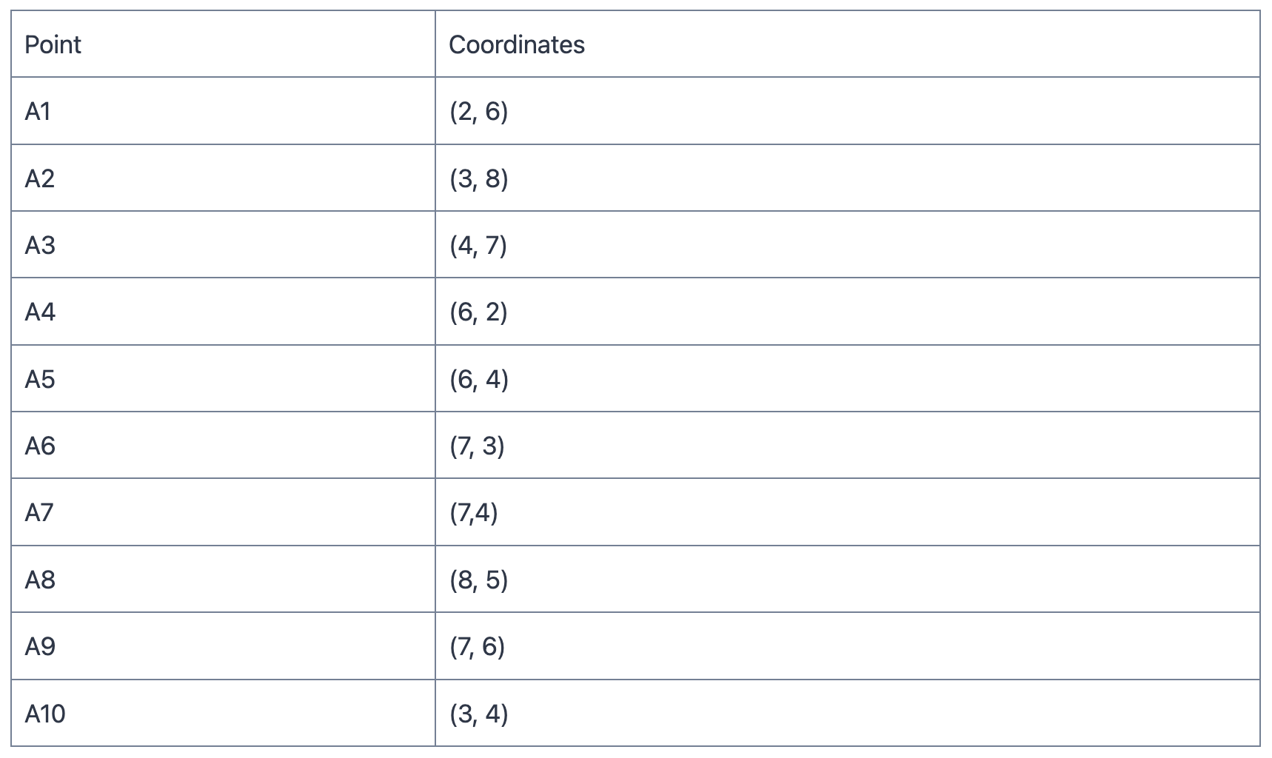
K-Medoids Numerical

Slide 63
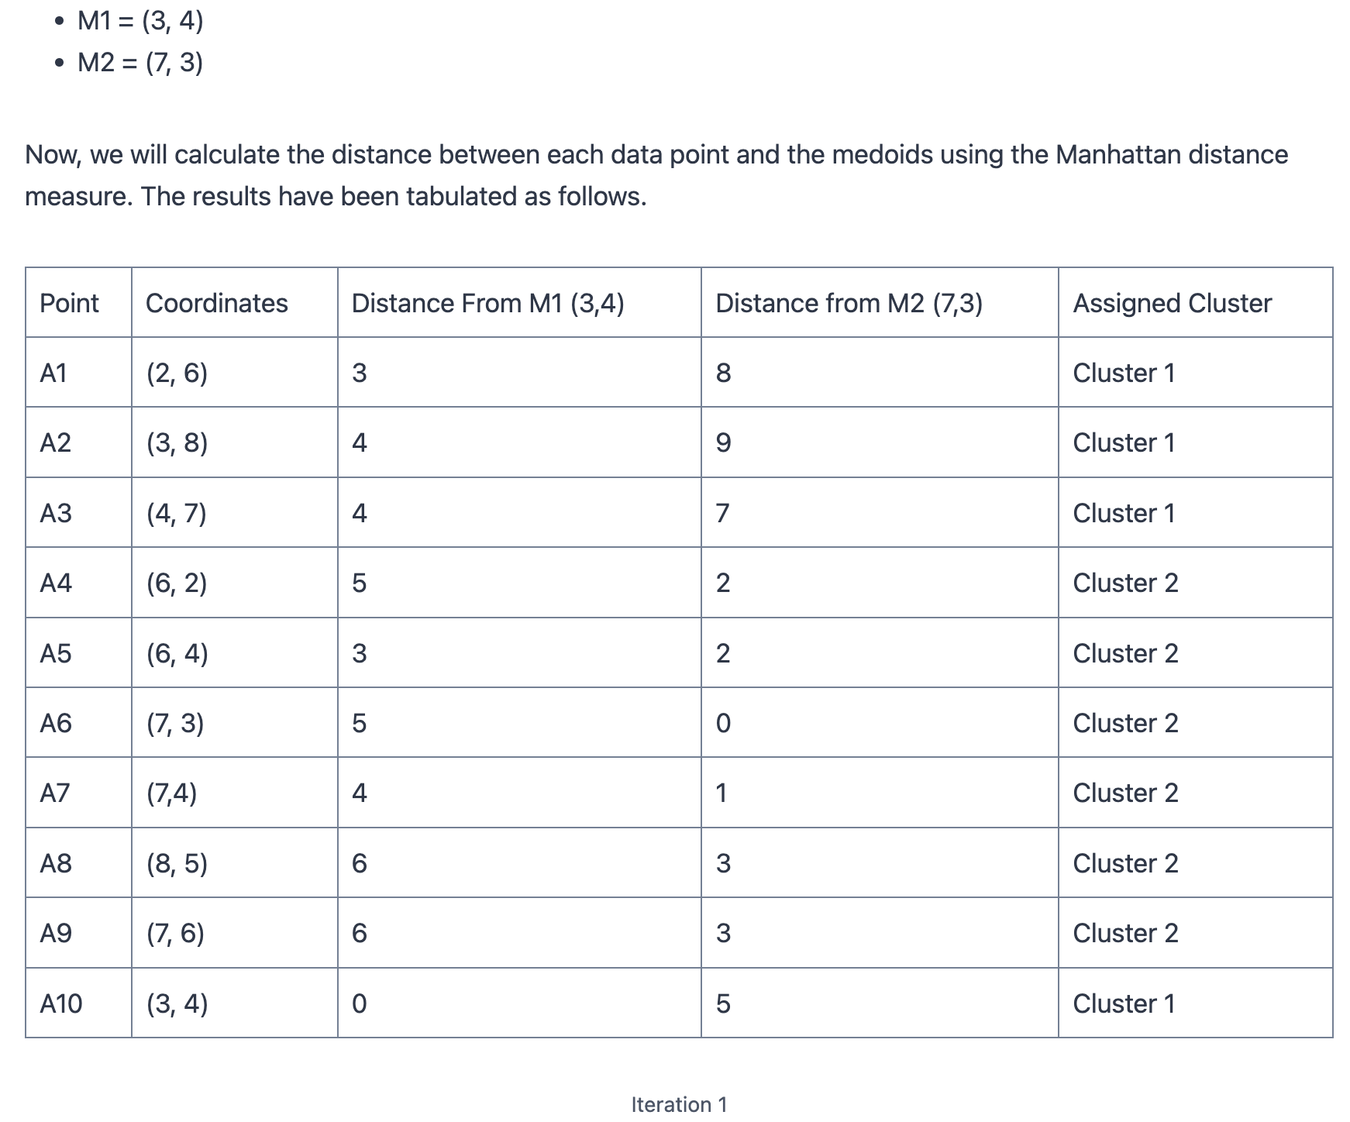

Slide 64
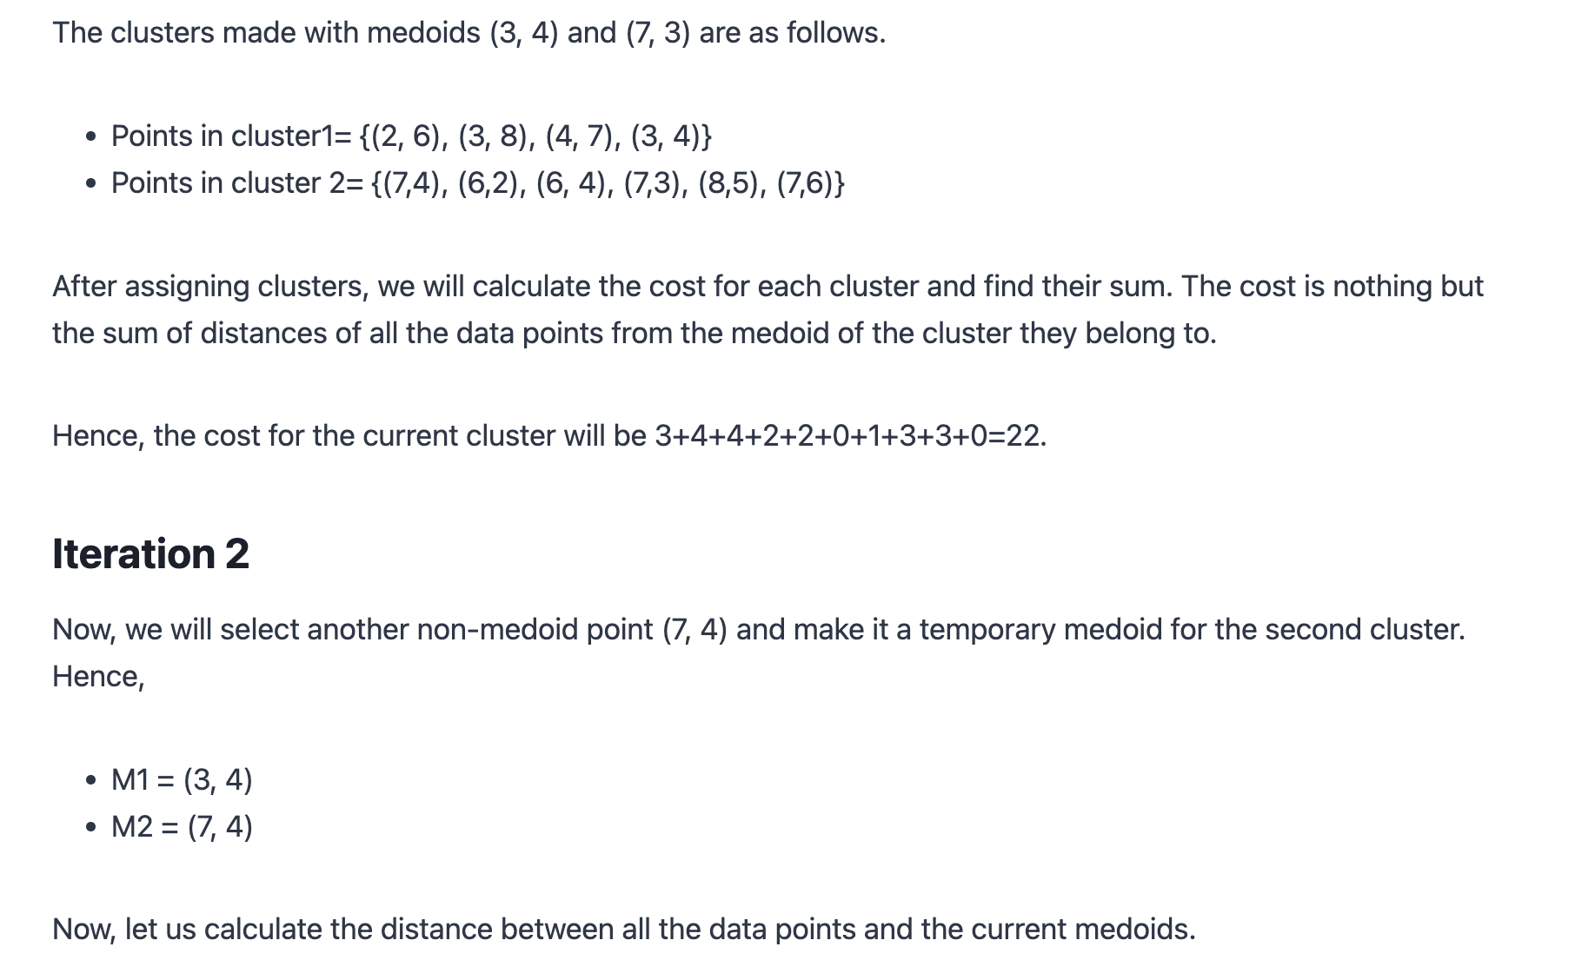

Slide 65
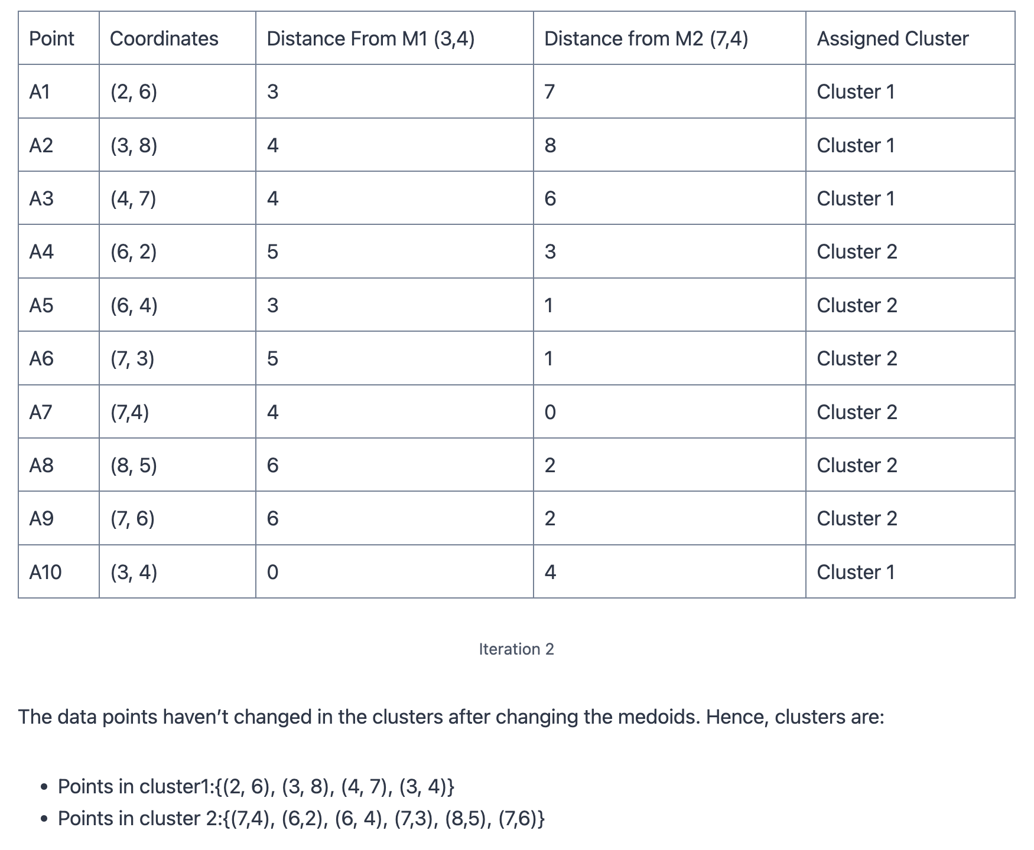

Slide 66
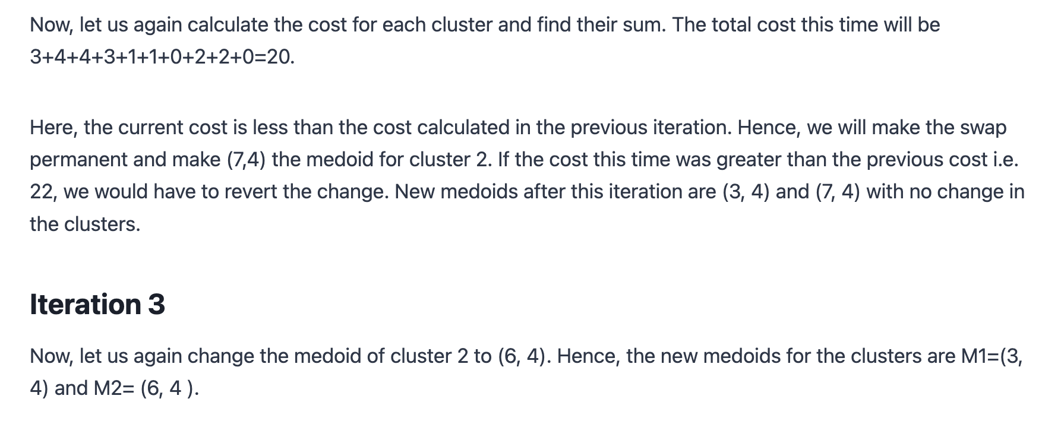

Slide 67
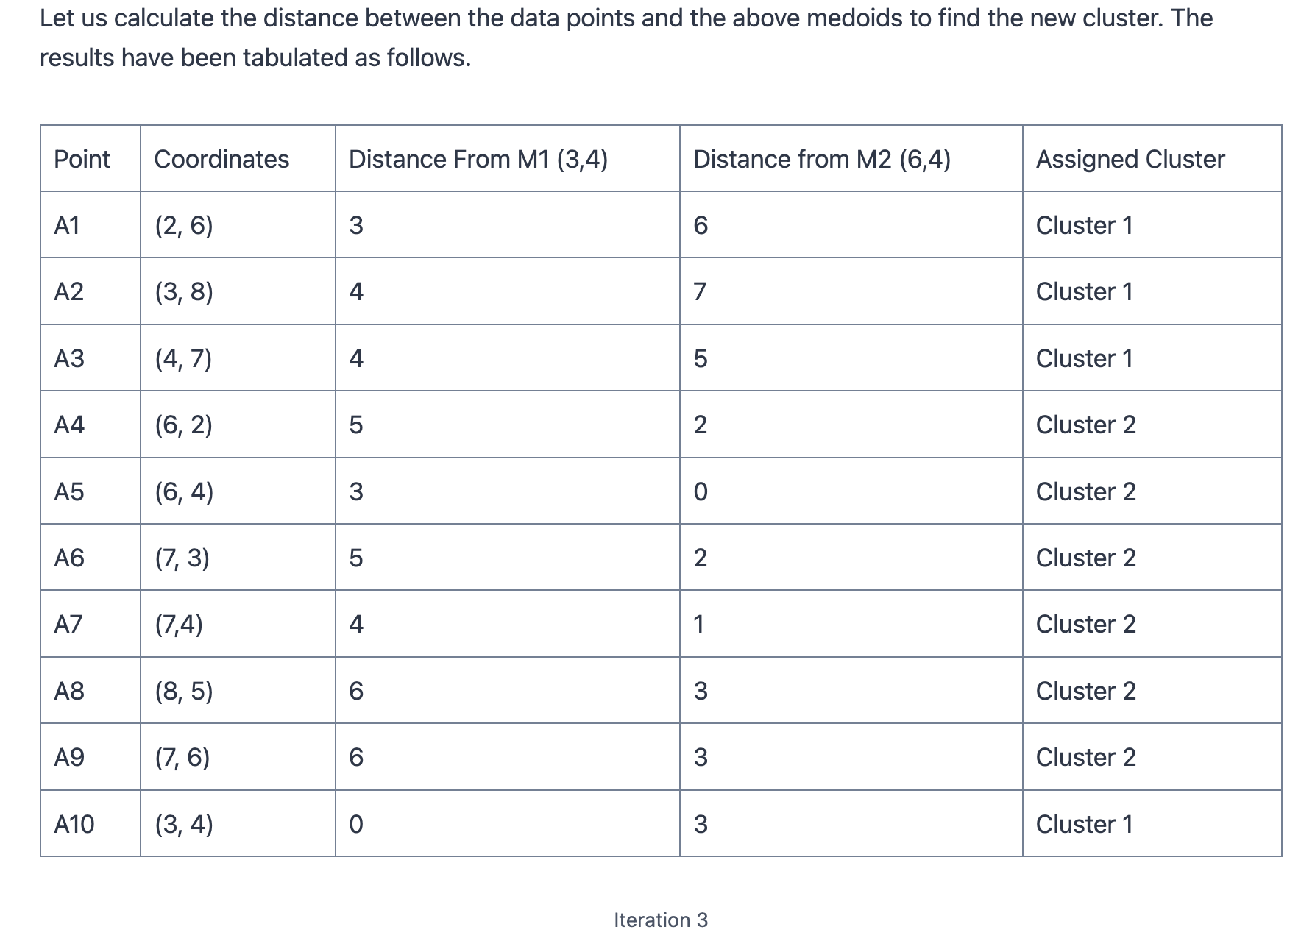

Slide 68
